Slide 1

Airlines customer loyalty program Analyzing Data from Northern Lights Air (NLA)
By- Yoginder Singh Sandhu

Slide 2
OVERVIEW
This project focused on analyzing the loyalty program data from Northern Lights Air (NLA), a fictitious airline based in Canada.
The analysis covered the impact of a promotional campaign on loyalty program enrollments, demographic adoption, flight bookings during summer, and flight activity by province.
Key areas of analysis included:
Promotional Campaign Impact: Evaluating the success of a campaign aimed at increasing loyalty program memberships.
Demographic Adoption: Analyzing which demographics were more inclined to enroll in the loyalty program during the campaign.
Summer Flight Bookings: Assessing the effect of the promotional campaign on the number of flights booked during the summer months.
Flight Activity by Province: Understanding regional differences in flight bookings among loyalty program members.

Slide 3
Objective
Primary Goal: To enhance the understanding of customer behavior and loyalty patterns by thoroughly analyzing the provided datasets.
Specific Objectives:
Analyze Customer Demographics: Understand the composition of the customer base by examining demographic variables such as gender, education level, salary, and marital status.
Flight Activity Patterns: Evaluate the flight activity of customers to identify trends in flight frequency, distance traveled, points accumulated, and points redeemed.
Enrollment and Cancellation Trends: Investigate the enrollment patterns to determine what factors contribute to successful enrollments and identify common reasons for cancellations.
Customer Lifetime Value (CLV): Assess the CLV across different customer segments to determine the most valuable customers and how to retain them.
Data-Driven Recommendations: Provide actionable insights and recommendations for enhancing the customer loyalty program based on the analysis findings.

Slide 4
Dataset Description
Data Source: MAVEN ANALYTICS (online open platform providing datasets for analysis)
Timeframe: Promotion ran between Feb - Apr 2018
Datasets Included:
Customer Flight Activity (CFA)
Customer Loyalty History (CLH)

Slide 5
Dataset Structure
Customer Flight Activity:
Columns:
Loyalty Number
Year
Month
Total Flights
Distance
Points Accumulated
Points Redeemed
Dollar Cost Points Redeemed
Rows: 392,936 entries
Customer Loyalty History
Columns:
Loyalty Number
Country
Province
City
Postal Code
Gender
Education
Salary
Marital Status
Loyalty Card
CLV (Customer Lifetime Value)
Enrollment Type
Enrollment Year
Enrollment Month
Cancellation Year
Cancellation Month
Rows: 16,737 entries

Slide 6
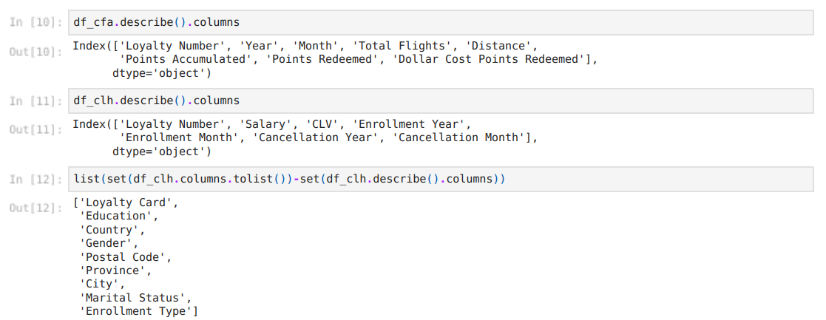
.describe() – gives only numerical columns thus subtracted / reduced the numerical columns from total columns to get the categorial columns

Slide 7
Data preprocessing
Importing And Inspecting :
Imported the necessary libraries – Pandas(pd) , Numpy(np) , Matplotlib.pyplot(plt) , Seaborn(sns).
Imported the data by using the “read()” function .
Used functions like - head() ,tail(), info() and describe().
Handling Missing Values:
Identified missing values in 'Salary', 'Cancellation Year', and 'Cancellation Month’
Percentage of missing data for each column
Skewness Treatment:
Addressed skewness in the dataset and treated highly skewed columns using box-cox method.

Slide 8
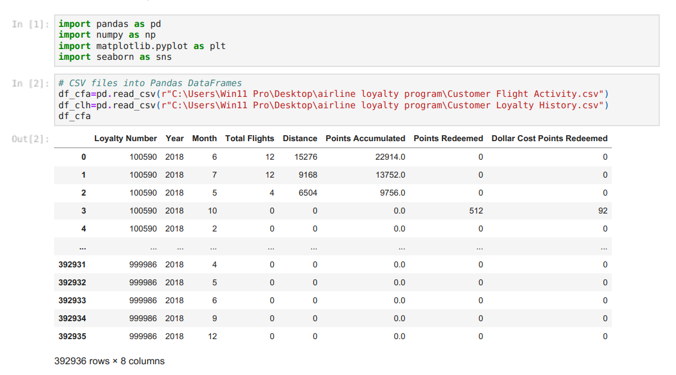
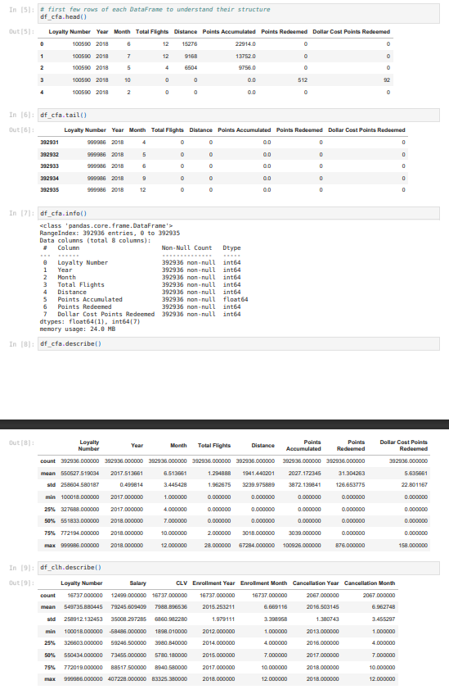

Slide 9
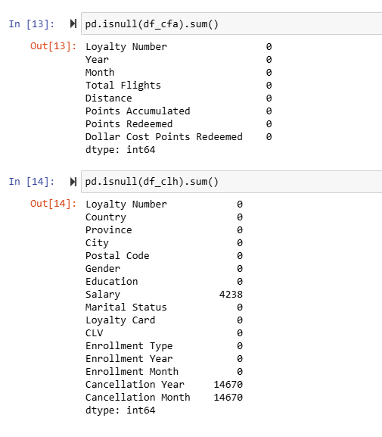
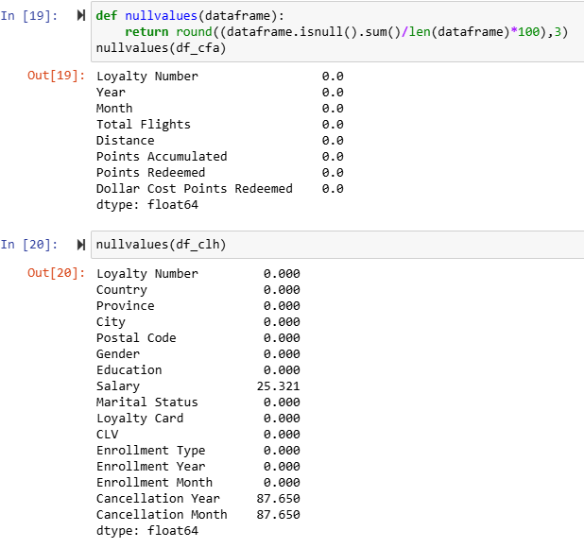
as per the visuals present it is clear that there are null values present but they are present in the salary column because some people are unsalaried such as unemployed and students null values in cancellations column says they haven’t cancelled their memberships with nla.

Slide 10
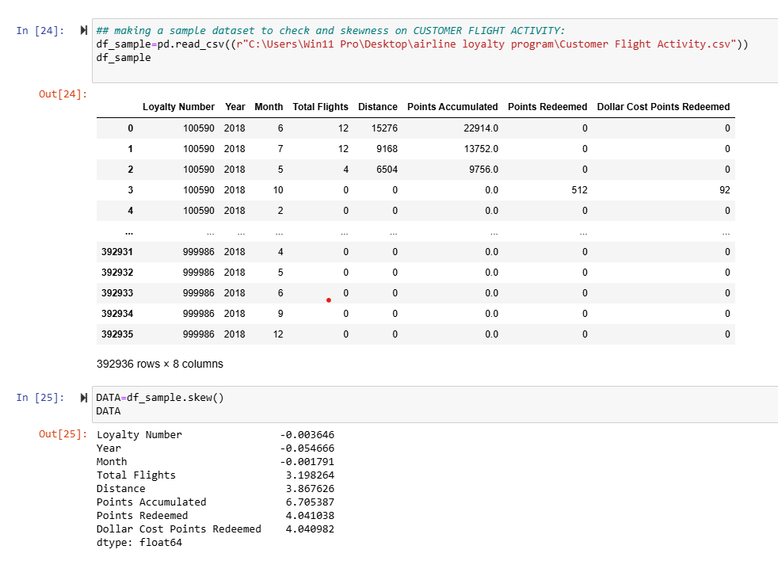
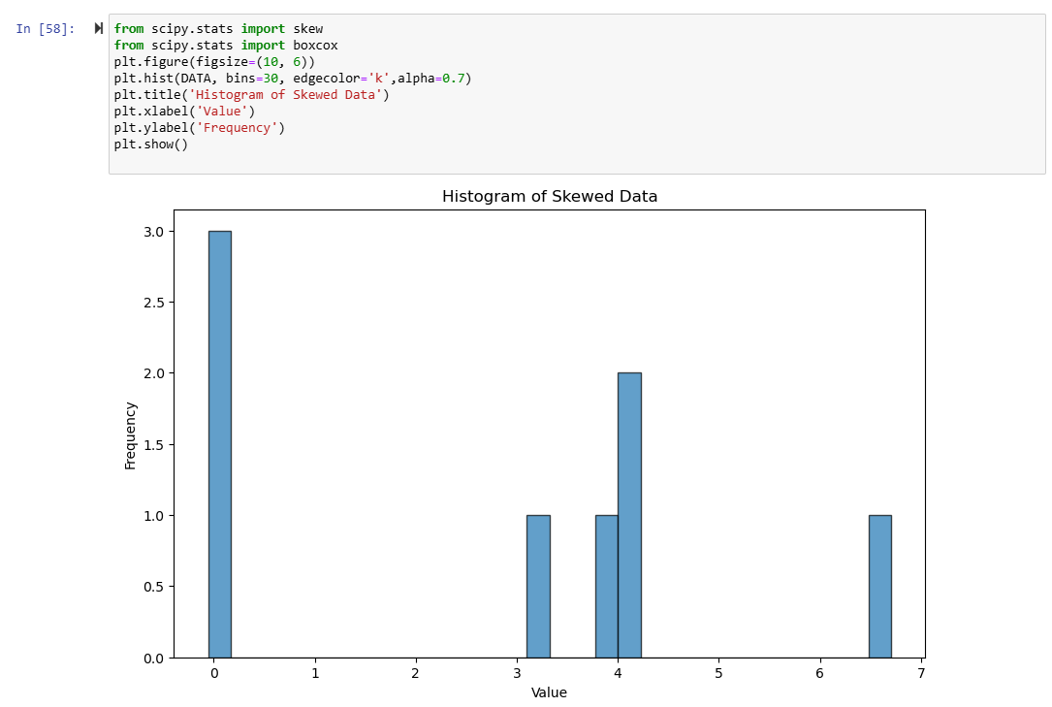
Skewness before treatment

Slide 11
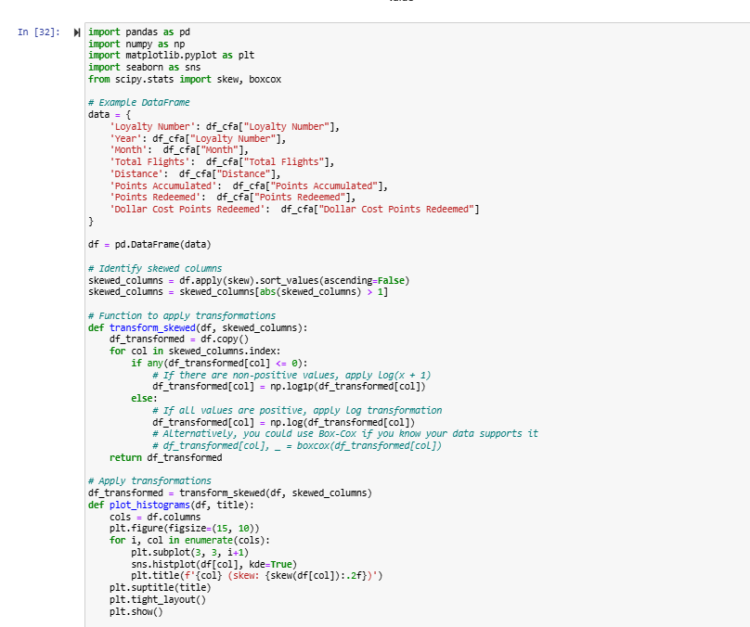
Code for Box-cox method Handling Skewed Data: The transformation is useful for reducing skewness in the data. This is particularly important when dealing with highly skewed data, which can distort statistical analyses and lead to incorrect conclusions.

Slide 12
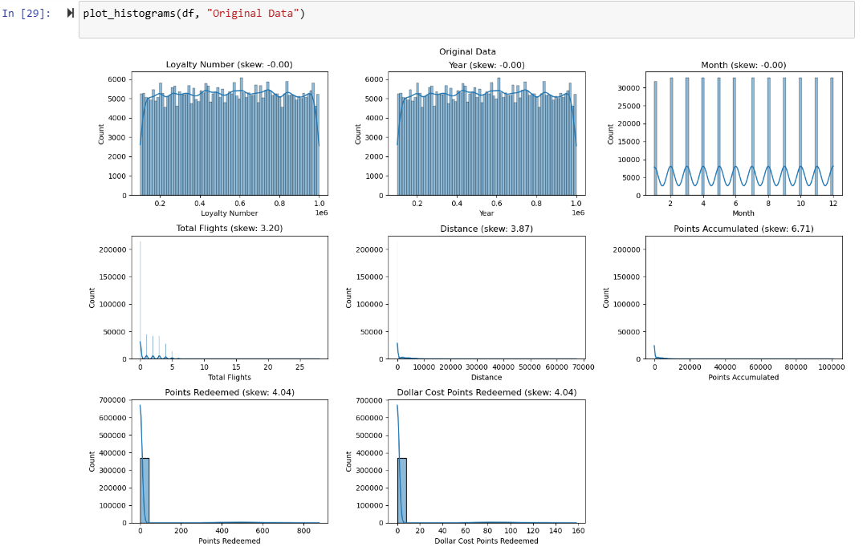
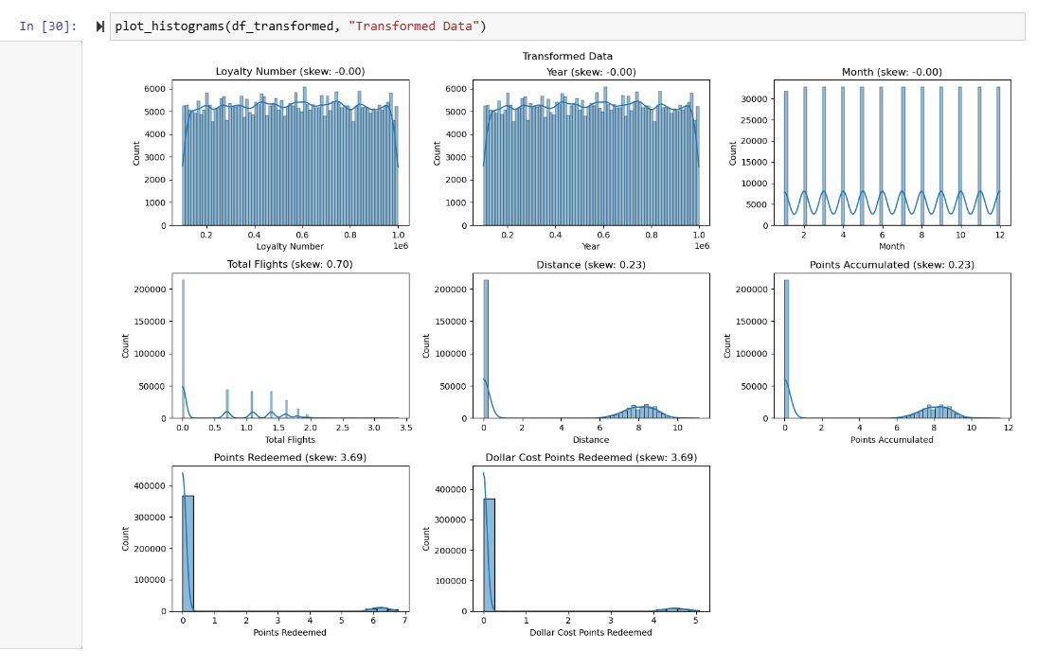
Skewness before and after treatment using box-cox method on column level

Slide 13
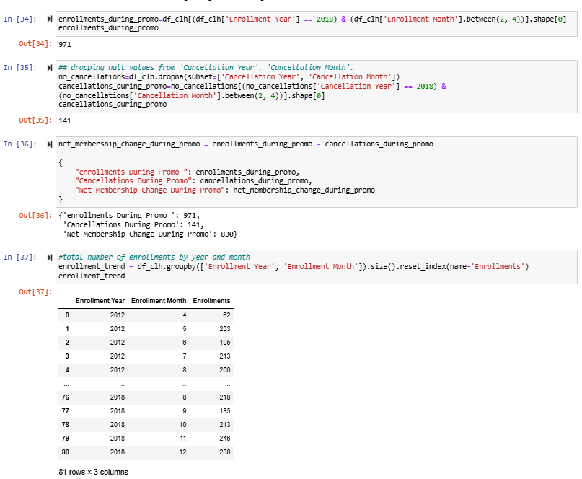
Impact of promotional campaign

Slide 14
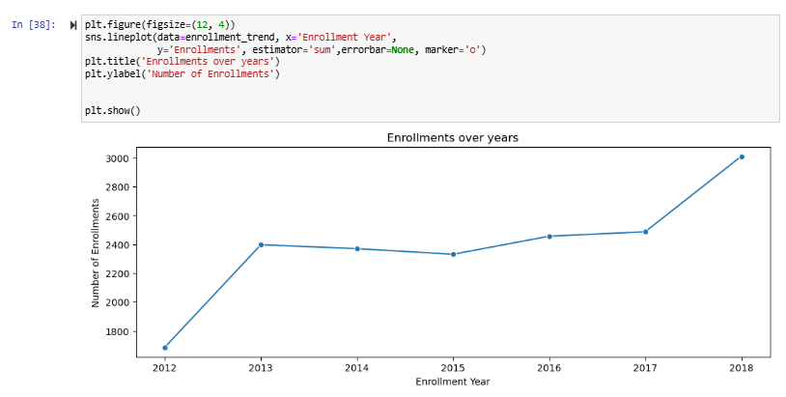
Enrolment trend from year 2012 to 2018
this indicates that the promotional campaign had a positive impact on the loyalty program's membership, with a significant net increase in memberships during the promotional period in 2018

Slide 15
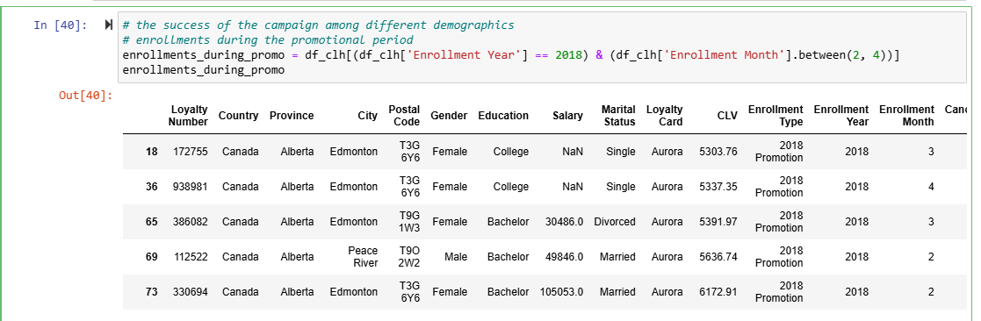
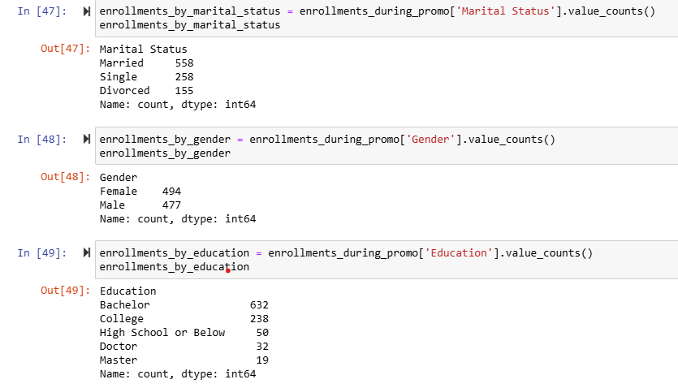
Demographic Breakdown of Loyalty Members SINGLE VARIATE ANALYSIS

Slide 16
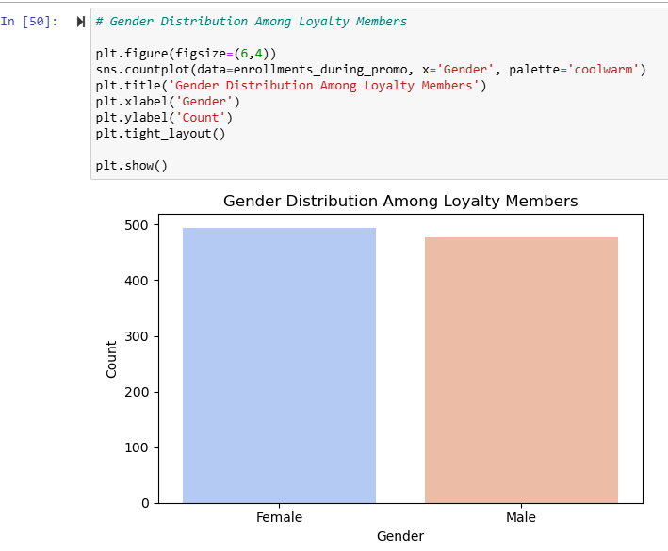
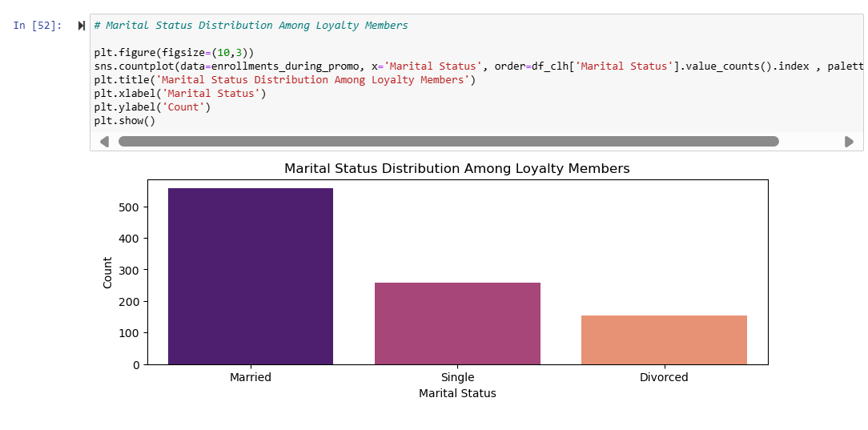
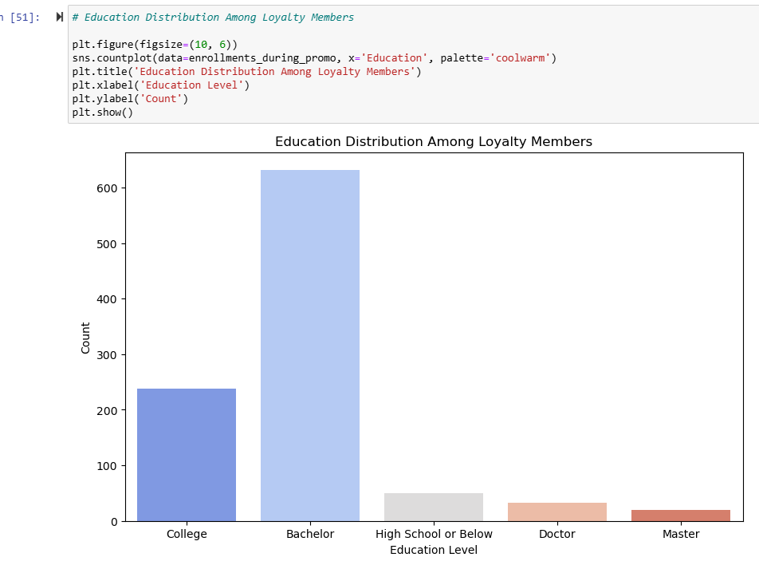
Graphical representation for each demographic

Slide 17
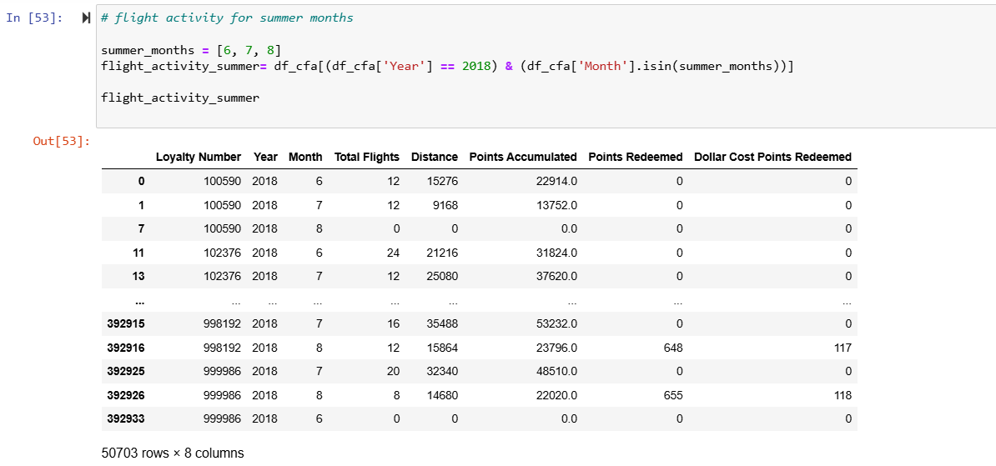
The impact of the campaign on booked flights during the summer months (June, July, August) BI VARIATE ANALYSIS

Slide 18
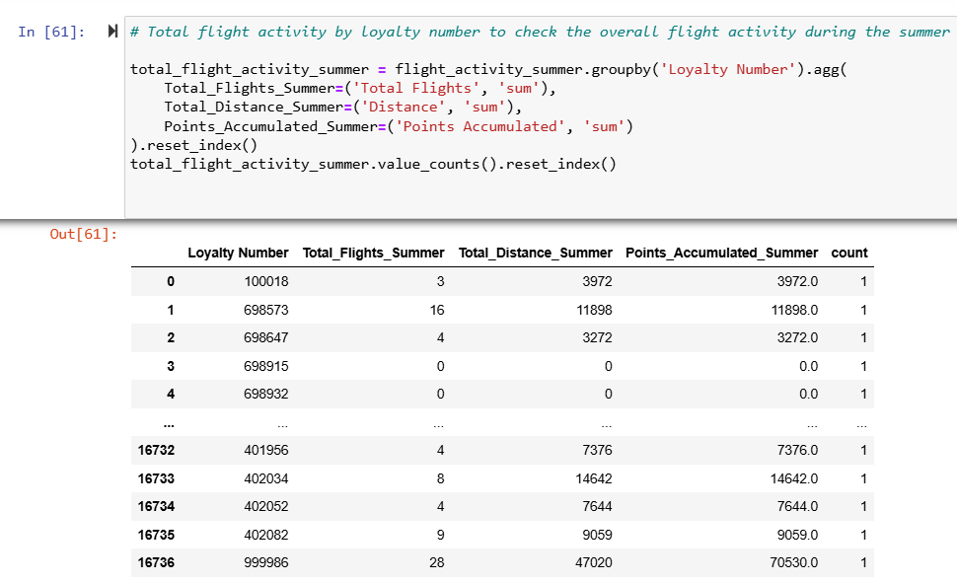
overall flight activity during the summer by loyalty number

Slide 19
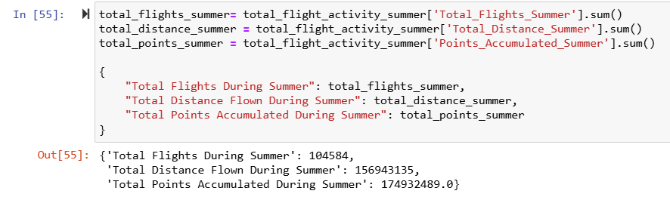
The total flight activity by all customers during summer months

Slide 20
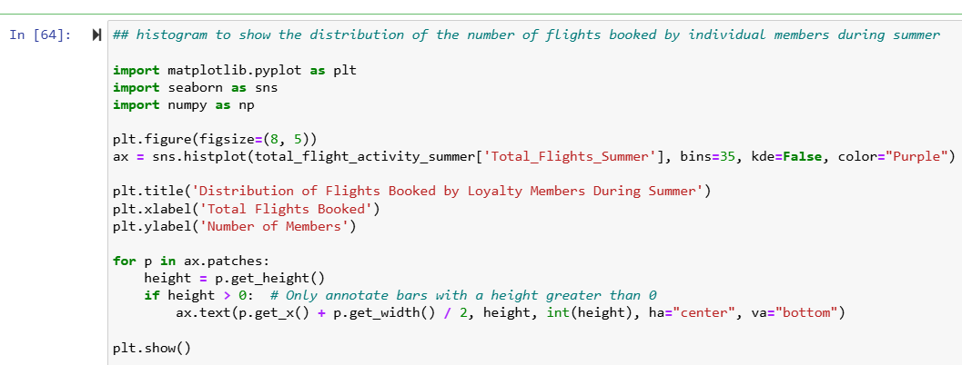
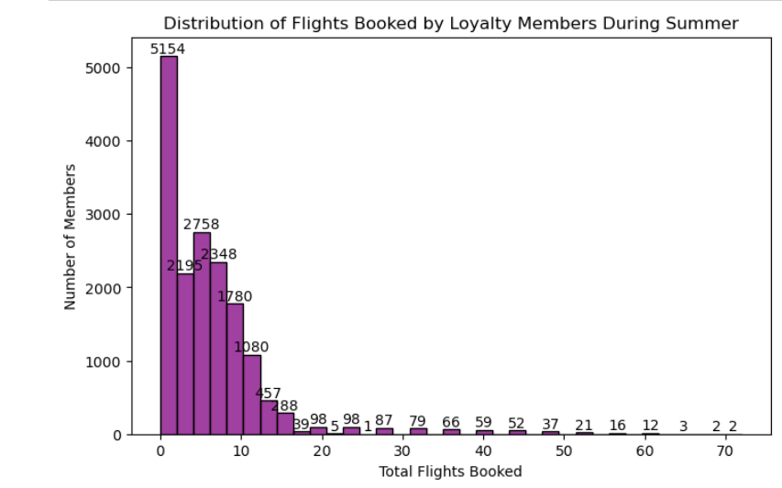
Distribution of Number of members by number of flight bookings

Slide 21
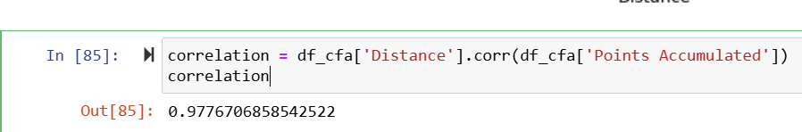
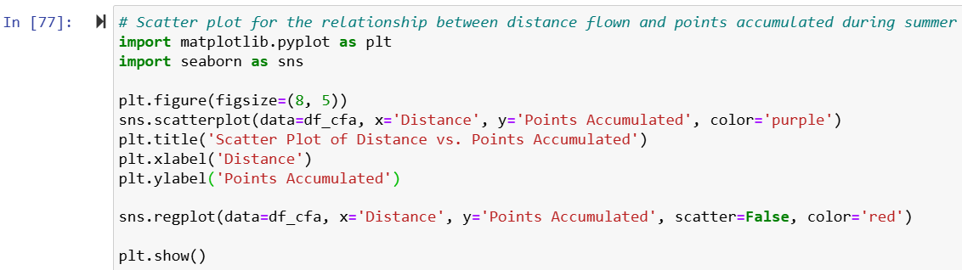
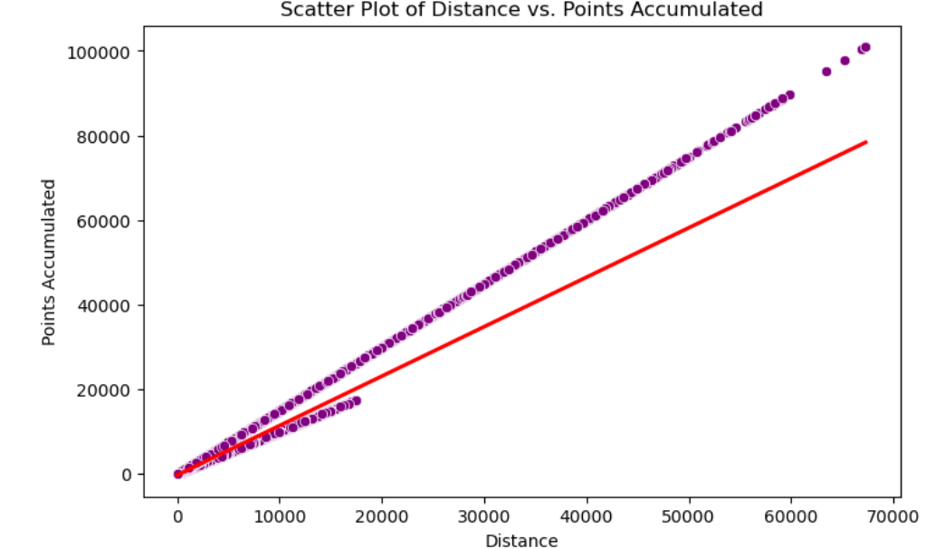
Correlation between distance flown and the points accumulated

Slide 22
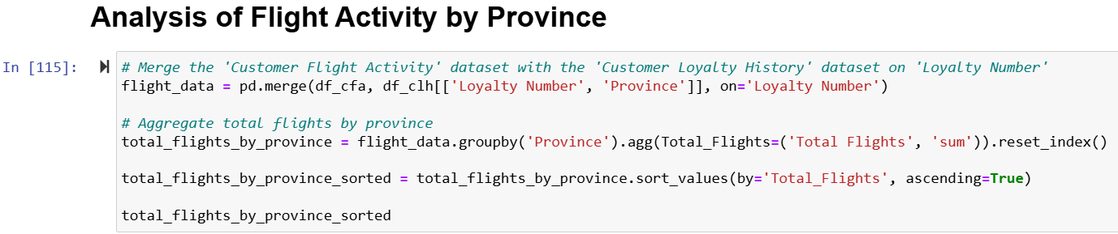
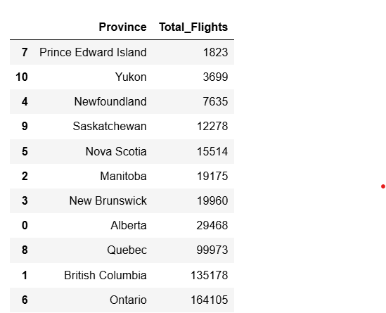
flight activity analysis by province

Slide 23
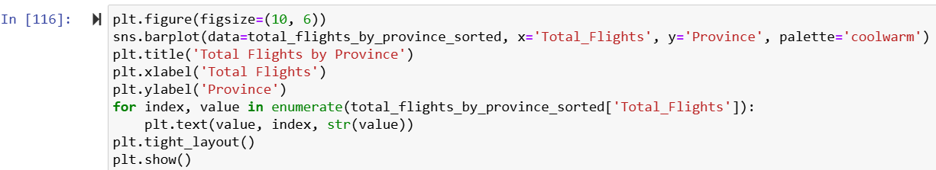
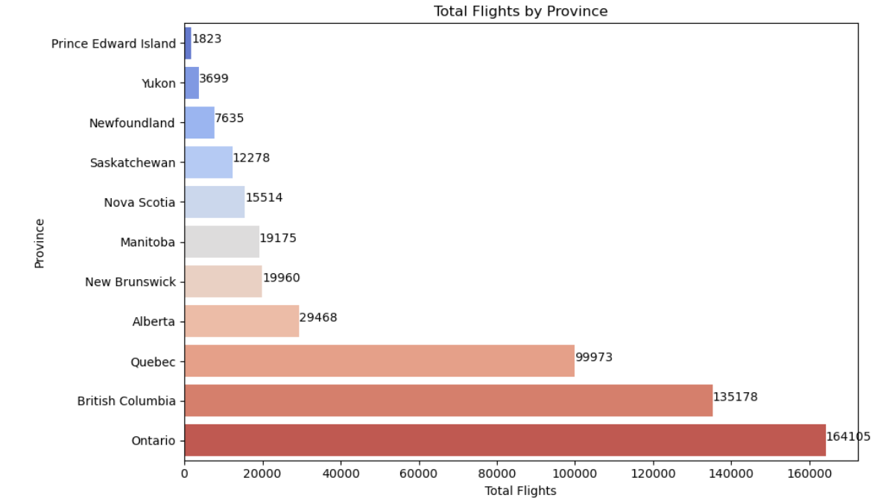

Slide 24
Challenges faced while making of project
Data Quality Issues:
Missing Values: Encountered missing values in critical columns such as 'Salary', 'Cancellation Year', and 'Cancellation Month', which could potentially skew analysis results.
Inconsistent Data Entries: Discovered inconsistencies in data entries, such as different formats for dates and categorical variables, requiring extensive cleaning and standardization.
Skewness and Outliers:
Data Skewness: Faced challenges with skewed data distributions in variables like 'Total Flights' and 'Points Accumulated', which needed transformation to ensure accurate analysis.
Outliers: Identified outliers in the dataset that could impact the analysis. Deciding whether to retain, transform, or remove these outliers was critical.
Handling Large Datasets:
Performance Issues: Processing and analyzing large datasets with over 390,000 entries in the 'Customer Flight Activity' table posed performance challenges. Optimization techniques were required to handle and process the data efficiently.
Integration of Multiple Data Sources:
Data Merging: Combining data from 'Customer Flight Activity' and 'Customer Loyalty History' tables required careful handling to maintain data integrity and ensure accurate analysis.
Data Consistency: Ensuring consistency across different datasets, especially when merging based on common keys like 'Loyalty Number'.

Slide 25
Insights
Successful Promotion:
The promotional campaign led to a significant net increase in loyalty program memberships, indicating its effectiveness in attracting new members.
Demographic Patterns:
The campaign saw higher adoption among certain demographics, particularly among
individuals with a Bachelor's degree and those who are married, suggesting that future campaigns could be tailored more specifically to target these groups.
Increased Summer Activity:
There was a notable increase in flight bookings during the summer months following the campaign, suggesting that the promotion not only boosted loyalty program enrollments but also encouraged immediate travel activity.
Regional Flight Activity Variations:
The analysis of flight activity by province revealed significant regional variations, with Ontario and British Columbia leading in total flights. This points to a strong market presence in these provinces and potential areas for growth in others.

Slide 26
Open the floor for any questions from the audience

